Slide 1
CMPE 202 Code For Fun
By Amit Bharadia, Dharma Dheeraj Chintala

Slide 2
USECASE Diagrams

Slide 3
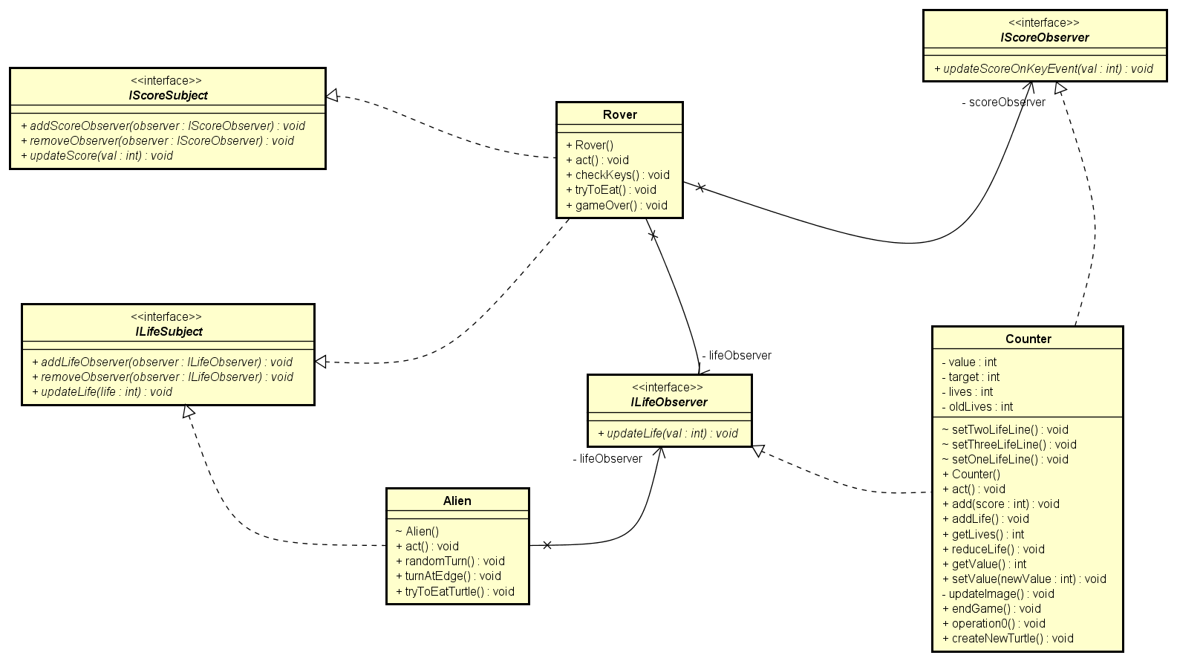
Observer Pattern

Slide 4
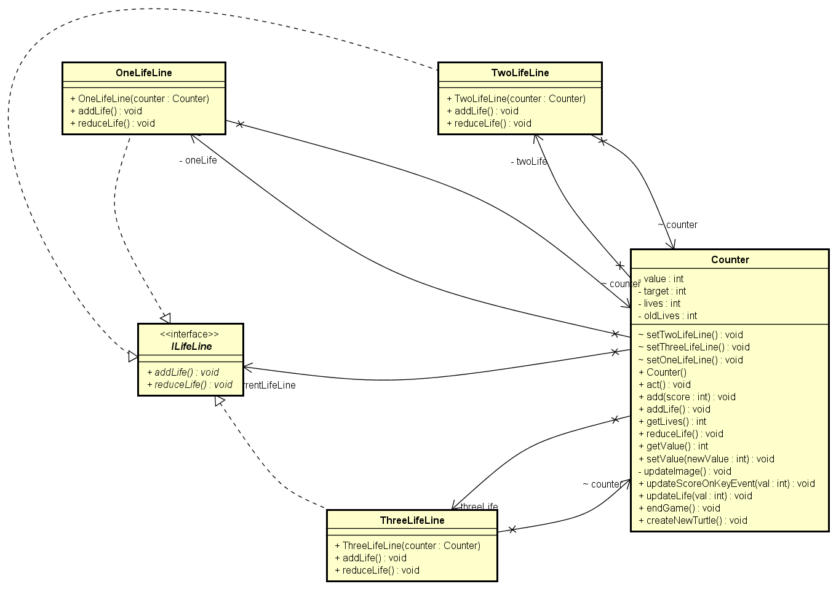
State Pattern

Slide 5
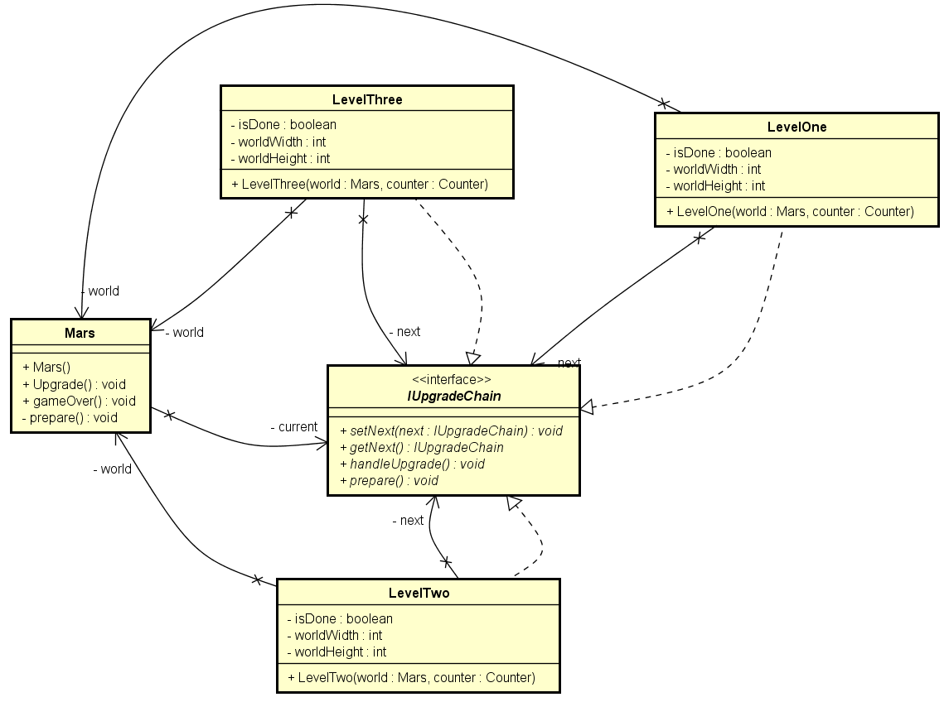
Chain of Responsibility Pattern

Slide 7
Class Diagrams

Slide 8
Activity Diagrams

Slide 9
SYSTEM SEQUENCE Diagrams

Slide 10
Burndown Chart

Slide 11
ScrUM BOARD

Slide 12
Links to our Github Repo
https://git
Link to our Team’s Project Board(on Github)
htt
Link to our Team’s Project Journal(on Github)
https://g
Link to our Team’s Sprint Task Sheet
https:/
Link to our Team’s Ad Video on Youtube:

